Slide 1
Mechanical Works Design
OK&3M
MECHANICAL WORKS · SCHOOL PROJECT, CAIRO
HVAC · Fire Fighting · Plumbing
Presented by Team OK&3M
HVAC
FIRE FIGHTING
PLUMBING

Slide 2
Meet Team OK&3M
Five minds, one mechanical design
M
M
O
K
M
Mahmoud Abd Elmaela
Mariem Mohamed
Omar Soliman
Kareem Tarek
Menna Nasser

Slide 3
Agenda
01
Introduction
02
Phase 1 · HVAC
03
Phase 2 · Fire Fighting
04
Phase 3 · Plumbing (Water Supply & Drainage)
05
Conclusion

Slide 4
Project Introduction
A school in Cairo, with the mechanical works designed in 3 phases
PHASE 1
PHASE 2
PHASE 3
HVAC
Fire Fighting
Plumbing
VRV system with individual control for every classroom, plus fan coil units
Sprinklers, extinguishers, zone control valves, pump room and stair pressurization
Water supply sized by WSFU and GPM, and drainage sized by DFU and slope

Slide 5
System Selection
01
PHASE 1 · HVAC
Project type
Indoor and outdoor units selected based on the nature of the project: a school with many classrooms
VRV system
Chosen because the cooling load changes between classrooms and during the day
Individual control
Each classroom has its own control, so it runs only when needed
Fan coil units
Fan coil units used as well in the spaces that suit them

Slide 6
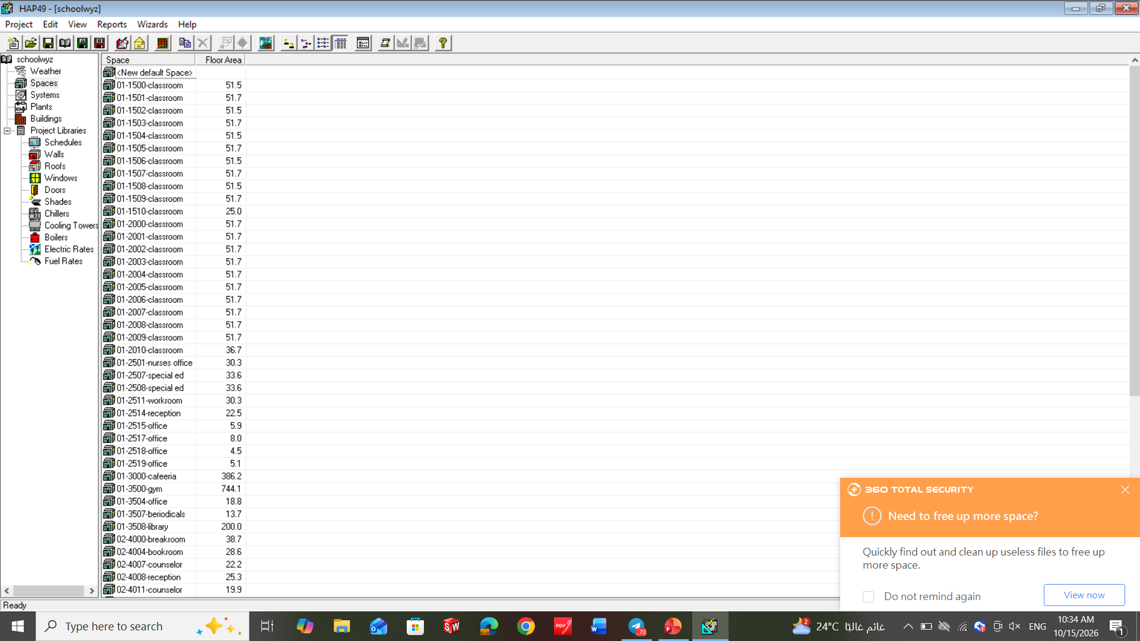
Heat Load Calculation
01
PHASE 1 · HVAC
HAP software
Heat loads for every room calculated using HAP (Hourly Analysis Program)
Inputs
Building envelope, occupancy, lighting, equipment and ventilation entered for each space
Results
Cooling load of each room used to size the indoor and outdoor units
Verification
Several rooms calculated manually to confirm the HAP results are correct

Slide 7
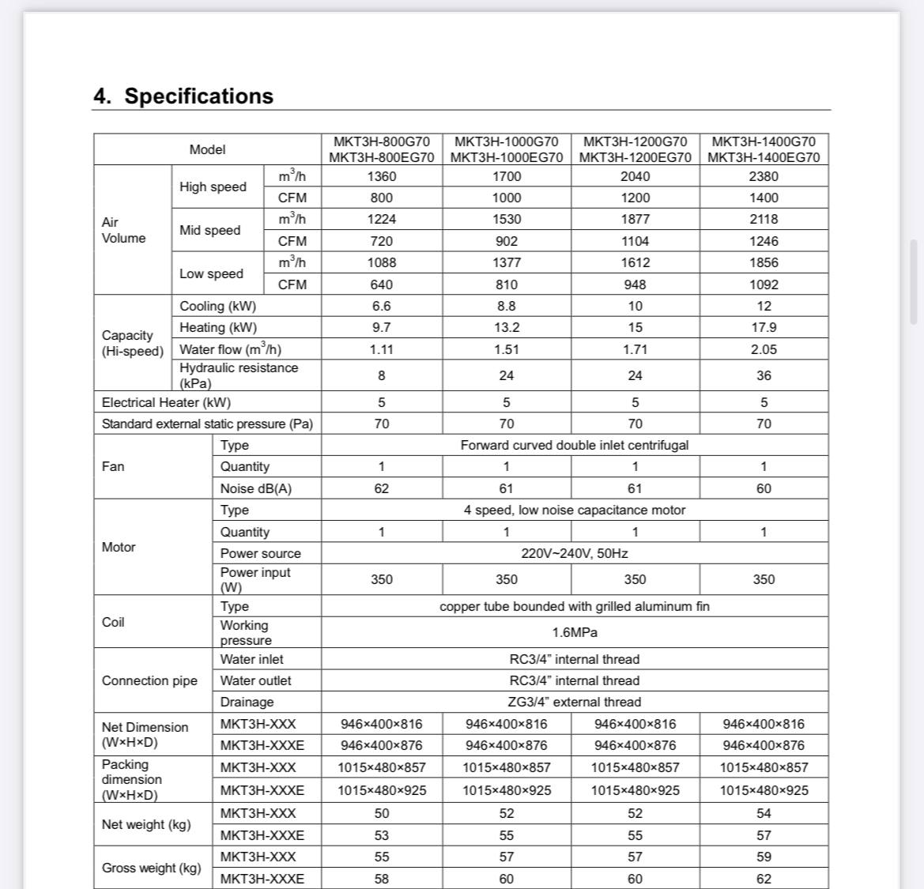
Equipment Selection
01
PHASE 1 · HVAC
Catalogs
Indoor and outdoor units selected from manufacturer catalogs
Matching the load
Unit capacity chosen to cover the calculated load of each room
Outdoor units
Outdoor units selected to serve the group of indoor units connected to them
Fan coils
Fan coil units selected from catalogs for the spaces that use them

Slide 8
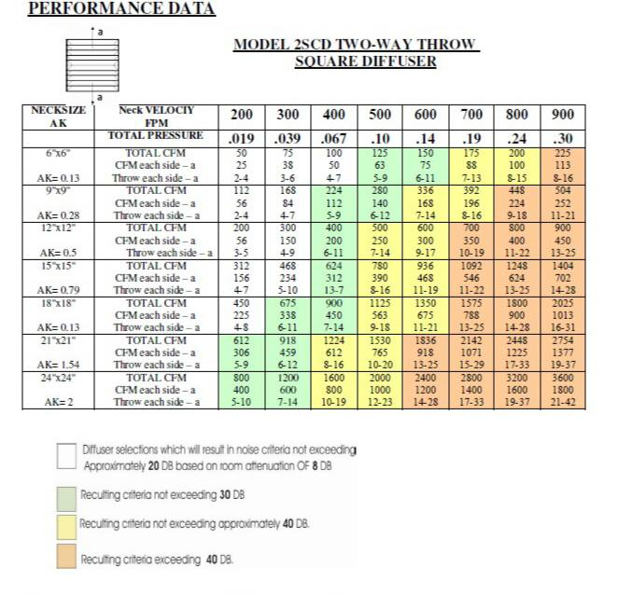
Air Outlets
01
PHASE 1 · HVAC
Ceiling type
Outlet type chosen based on the ceiling type in each space
Selection
Outlets selected from manufacturer catalogs and sized for the required airflow
Distribution
Outlets distributed over the ceiling for even air coverage

Slide 9
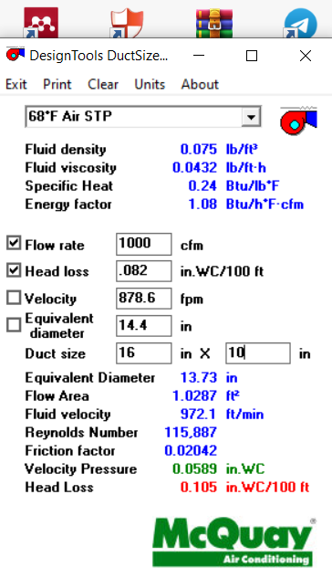
Ducts
01
PHASE 1 · HVAC
Duct sizing
Duct sizer used to size the duct network from the airflow of each outlet
Drawings
Layouts prepared with the final duct and pipe sizes

Slide 10
Ventilation, ESP & BOQ
01
PHASE 1 · HVAC
Toilet ventilation
Ventilation designed for the toilets, with the extract airflow calculated
ESP calculations
External static pressure calculated for the duct network
Quantity take-off
Quantities of units, ducts, pipes and outlets counted from the drawings

Slide 11

3D Model
01
PHASE 1 · HVAC
Autodesk Viewer
The HVAC project is available as a 3D model in Autodesk Viewer
How to view
Scan the QR code with your phone to open the model
What you see
Units, ducts, pipes and outlets placed in the building

Slide 12
About VRV
01
PHASE 1 · HVAC
What is VRV
Variable Refrigerant Volume: one outdoor unit serves several indoor units
How it works
The compressor changes the refrigerant flow to match the load
Why here
The school has a variable load and needs individual control for each classroom
Benefits
Energy saving at part load and flexible zoning

Slide 13
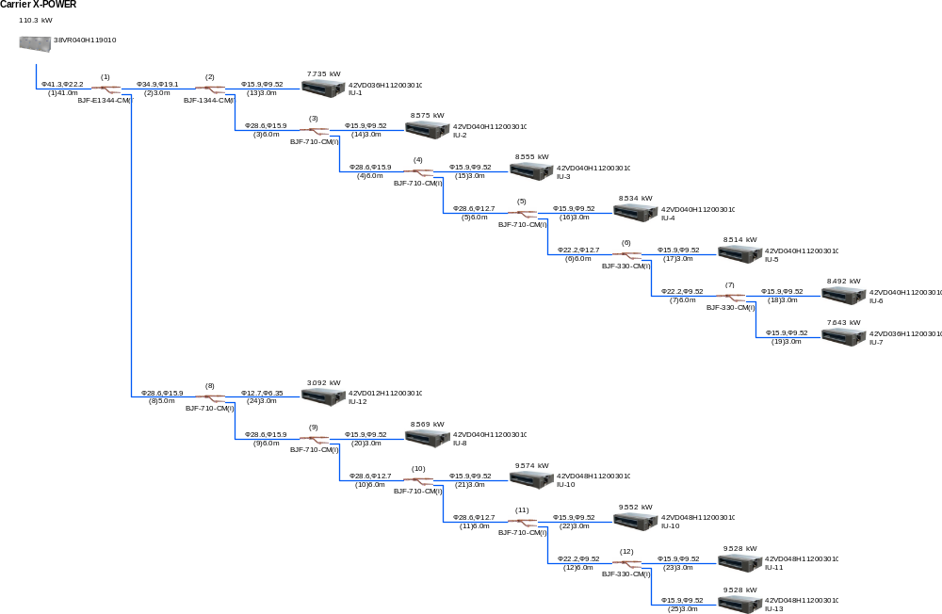
Project Photos
01
PHASE 1 · HVAC

Slide 14
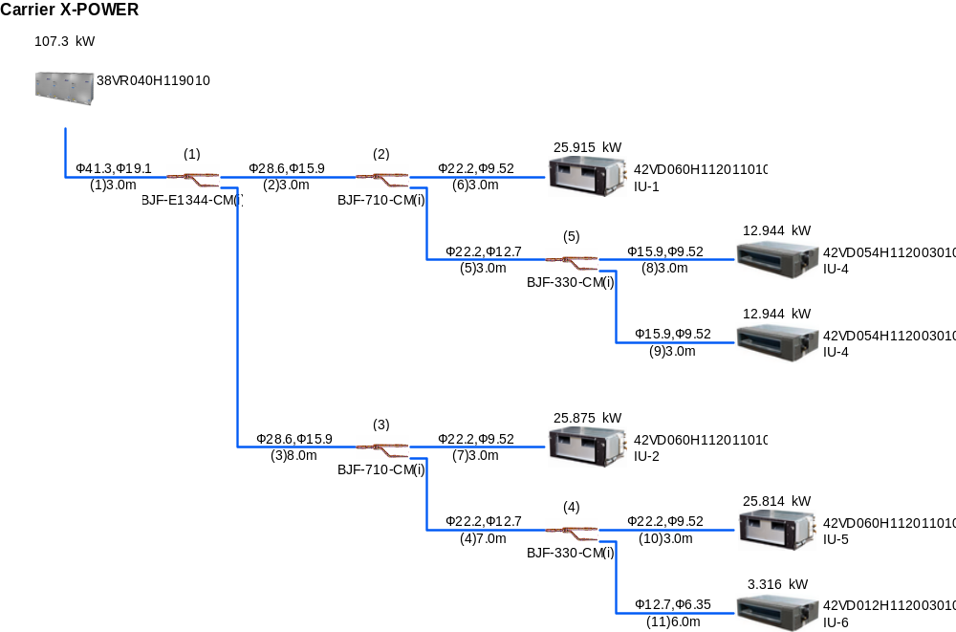
Project Photos
01
PHASE 1 · HVAC

Slide 15
Layout & Devices
02
PHASE 2 · FIRE FIGHTING
Architectural plans
Reviewed first to understand the ceilings and room layouts
Sprinkler types
Types chosen based on the ceiling type in each space
Sprinkler distribution
Sprinklers distributed over the floors of the building
Extinguishers & hose boxes
Fire extinguishers and fire hose boxes placed across the building

Slide 16
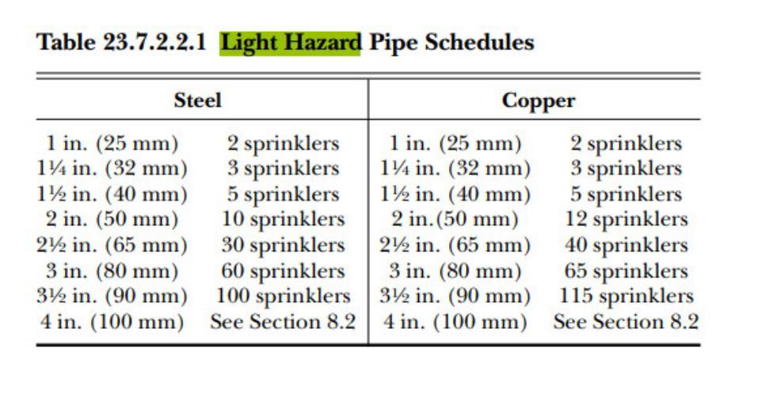
Piping & Zoning
02
PHASE 2 · FIRE FIGHTING
Sprinkler pipes
Pipe network drawn to feed all the sprinklers
Pipe diameters
Diameters taken from the code tables
Zone control valves
Zones separated using zone control valves

Slide 17
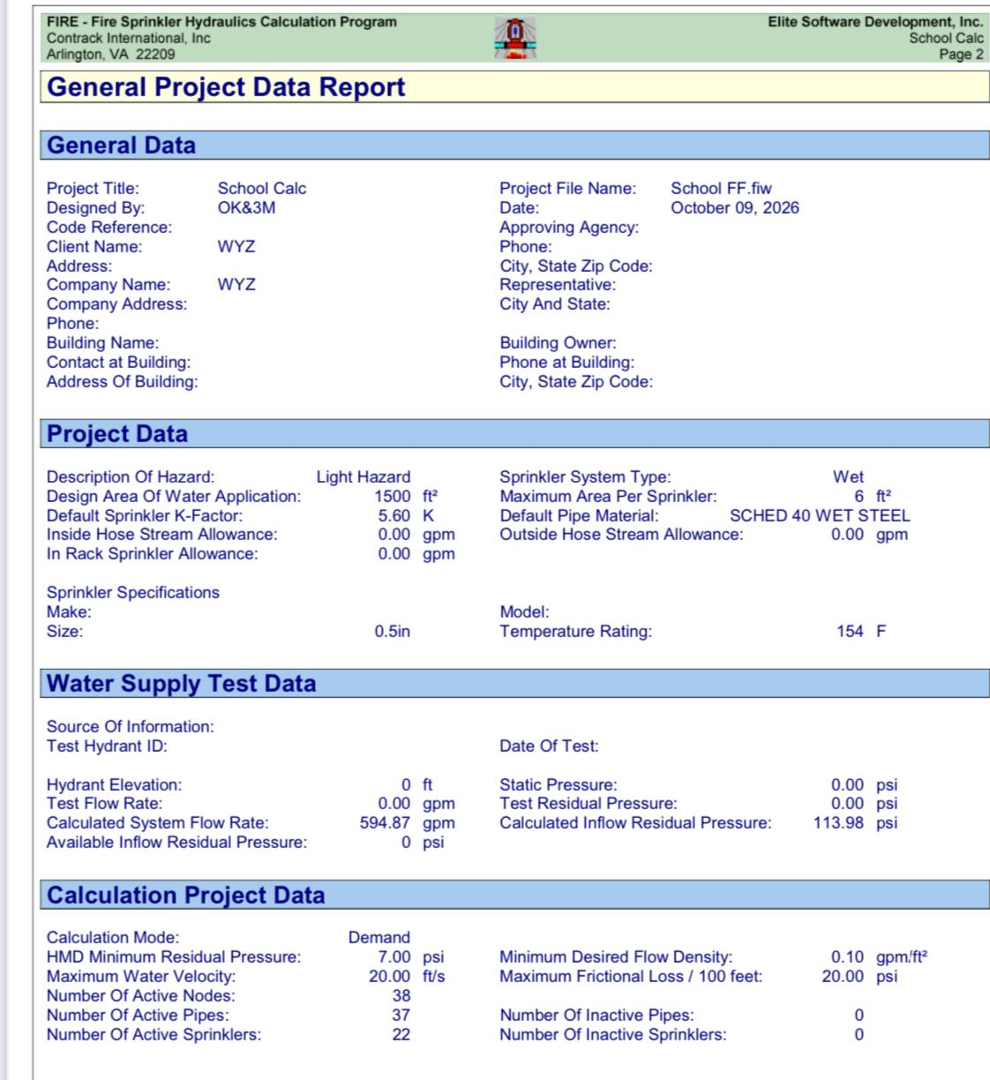
Hydraulic Calculations
02
PHASE 2 · FIRE FIGHTING
Software
Hydraulic calculations done with Elite software
Purpose
Confirm the flow and pressure needed at the most demanding sprinklers
Results
Used to check the pipe sizes and select the pumps

Slide 18

Pump Room
02
PHASE 2 · FIRE FIGHTING
Pump room
Designed to supply the required flow and pressure
Equipment
Pumps selected from the hydraulic calculation results
Details
Scan the QR code to see the full pump room and tank details

Slide 19
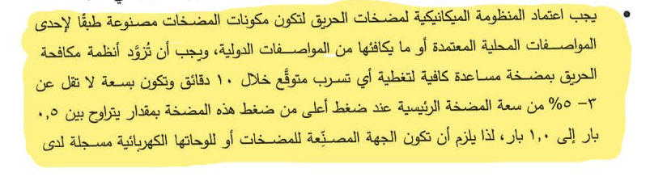
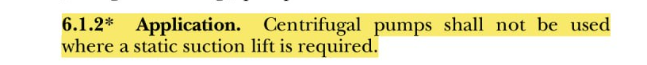
Notes From Code :
02
PHASE 2 · FIRE FIGHTING

Slide 20
Supporting Systems
02
PHASE 2 · FIRE FIGHTING
Siamese connection
Allows the fire department to supply water to the building system
Fire hydrant
Water point used for fire fighting
Stair pressurization
Keeps smoke out of the staircases during a fire

Slide 21
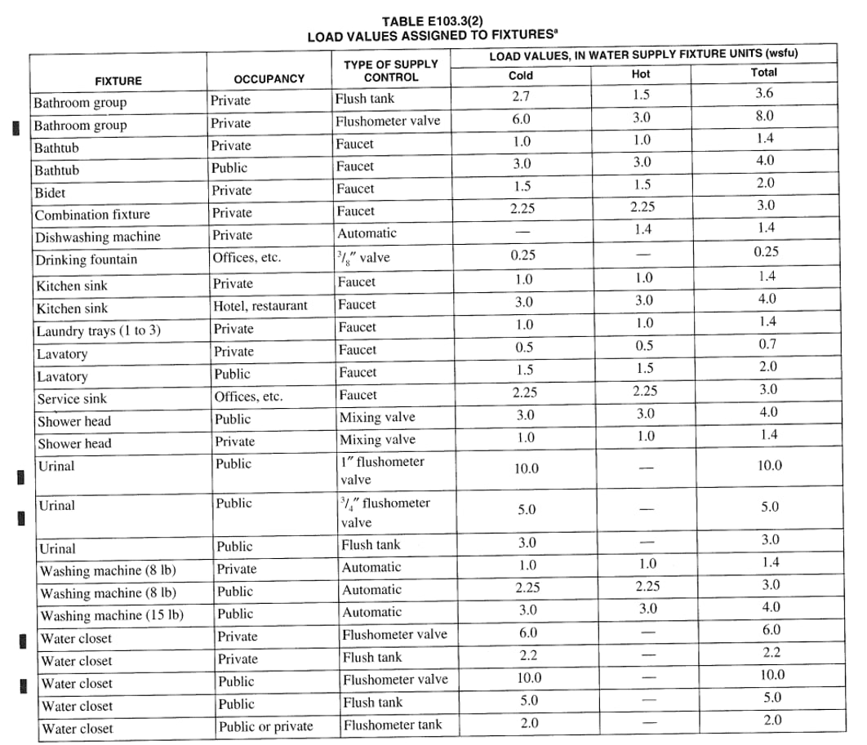
Water Supply
03
PHASE 3 · PLUMBING
Plumbing fixtures
Fixtures selected for the toilets and service rooms
WSFU from IPC
Water supply fixture units of each fixture taken from the IPC code
Units to GPM
Fixture units added together, then converted to flow in GPM
Pipe size
Flow converted to pipe diameter in inches to design the pipes

Slide 22
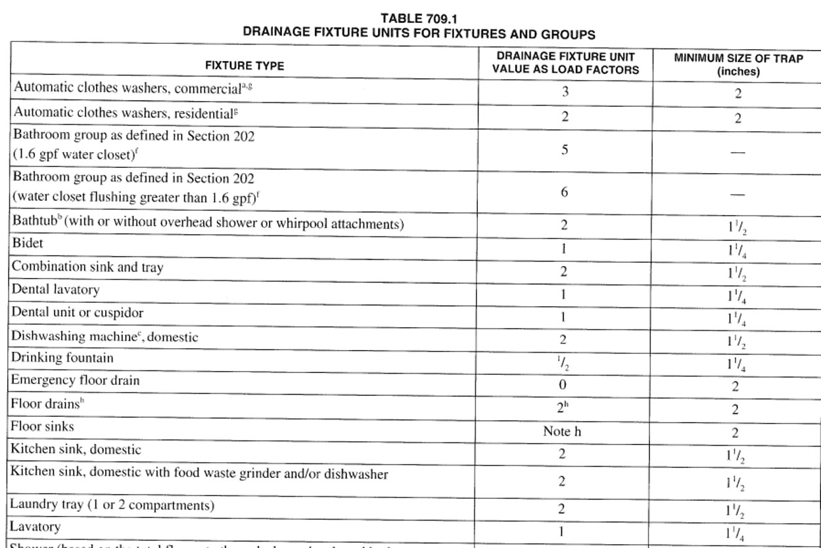
Drainage
03
PHASE 3 · PLUMBING
DFU from the code
Drainage fixture units of each fixture taken from the code
Horizontal branch
Total DFU converted to pipe diameter in inches for the horizontal branch
Slope
Slope selected for the horizontal drain pipes
Pipe design
Drainage pipes designed using the selected sizes and slope

Slide 23
Thank You
Questions & Discussion · Team OK&3M
Photo
Photo
Photo
Photo
Photo
Omar Soliman
Kareem Tarek
Mahmoud Abd Elmaela
Mariem Mohamed
Menna Nasser

